Slide 1
Understanding and mitigating zoonotic spillover events
in declining biodiversity hot- spots in Southeast Asia
Kick-off meeting May 22nd 2023 , The Empress Hotel, Chaing Mai, Thailand

Slide 2
Outline
Rationale
What is PRESTO?
Partners
IJL PRESTO coordinators
Long term objectives
How is PRESTO funded?
Proposed working groups
Brief overview of ongoing projects

Slide 3
Thailand and Laos share very similar ecosystems and socio-cultural practices
Global hotspot of biodiversity
Potential hotspot for spillover events
Viral zoonoses (i.e., Nipah/Hendra virus infection, H1N1 Swine flu, SARS, COVID-19)
Development of economic corridors and their integration into the new Silk Roads
Climate change and human activities leading to biodiversity loss
Southeast Asia (SEA) - Greater Mekong region
3

Slide 4
IJL PRESTO : an international, multidisciplinary One-Health approach collaboration
PRotect
Biodiversity
Land and pristine territories
Vulnerable animals and human populations
dEtect
STOp
PRotect
STOp
High risk activities
Emerging infectious diseases outbreaks
dEtect
Zoonoses emergence
Spillover
Spillback
4
Notes:
The IJL PRESTO (International Joint Laboratory on PRotect-dEtect-STOp) is a research collaboration between the French National Research Institute for Sustainable Development (IRD), the University of Health Sciences (Lao PDR), and Chiang Mai University (Thailand). The IJL PRESTO is focused on understanding and mitigating the risk of zoonotic spillover events in declining biodiversity hot-spots in Southeast Asia.
The IJL PRESTO is a multidisciplinary collaboration that brings together experts from a variety of fields, including ecology, epidemiology, virology, and social sciences. The IJL PRESTO is using a One Health approach to address the problem of zoonotic spillover, which recognizes that the health of humans, animals, and the environment are interconnected.
The IJL PRESTO is conducting research on a variety of topics related to zoonotic spillover, including:
The identification of high-risk areas for zoonotic spillover events.
The development of early warning systems for zoonotic spillover events.
The development of interventions to mitigate the risk of zoonotic spillover events.
The IJL PRESTO is also working to build capacity in Laos and Thailand to prevent and respond to zoonotic spillover events. The IJL PRESTO is training scientists, policymakers, and other stakeholders in Laos and Thailand in the latest methods for preventing and responding to zoonotic spillover events.

Slide 5
PRESTO Partners
Thailand
Chiang Mai University
Faculty of Associated Medical Sciences
Faculty of Science
Faculty of Veterinary Medicine
Faculty of Social Sciences
Mahidol University, Faculty
of Tropical Medicine
Kasetsart University.
Faculty of Veterinary
Technology
France
Montpellier University, Faculty of Science
Laos
University of Health Sciences
National University of Laos (NUOL)
National Animal Health Laboratory
Centre Infectiologie Lao Mérieux
ECC
FTB
5

Slide 6
PRESTO Co-ordinators
Sabrina LOCATELLI, PhD
Nicole NGO-GIANG-HUONG, PharmD, PhD
Woottichai KHAMDUANG, PhD
Molecular biologist, IRD researcher
Retroviruses, soil-transmitted helminths, opportunistic and neglected tropical diseases
At CILM-IRD-Laos since August 2021
Virologist, IRD researcher
Mother-to-child viral transmission, clinical virology and clinical research
AMS-IRD collaboration, Thailand since 2001
Assistant professor, virologist
Molecular virology, epidemiology
Faculty of Associated Medical Sciences, Chiang Mai University (AMS-CMU) since 2017

Slide 7
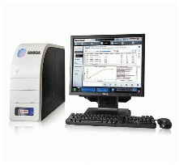
PRESTO Long-term objectives
PRotect
Identify biodiversity rich areas under anthropogenic pressure and potential outbreaks hotspots
Improve or validate new/rapid detection tests in animals and humans
Protect= dEtect as fast as possible
Teaching and training to increase the response capacity
5

Slide 8
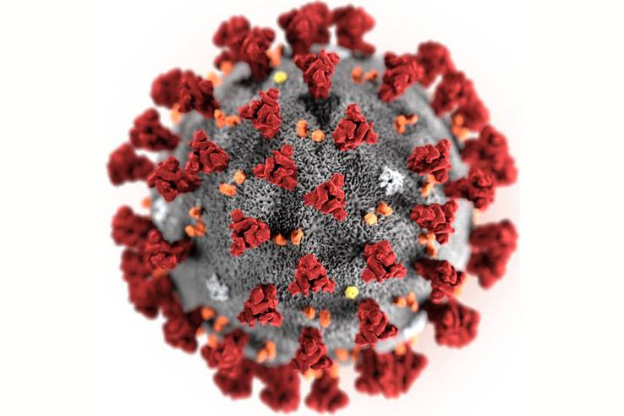
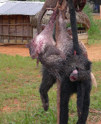
dEtect
PRESTO Long-term objectives
Identify animal reservoirs in wildlife and domestic animals
Characterize genetic diversity and epidemiology of pathogens of potential zoonotic emergence
Identify behavior risks of exposure and susceptible human populations
5

Slide 9
PRESTO Long-term objectives
STOp
Establish long-term collaboration and trust with institutional partners, communities and decision-making bodies.
Implement Research
Inform, advise and provide expertise to decision-makers/authorities to elicit rapid responses
5

Slide 10
Plan for 5 years budget - 40 K€/year
Committees, Data Management Plan, Coordination
16k
Communication
14k
Workshops
10k
30K
14K
50K
Consumables
30K
16K
10K
80K
Students support
80k
Missions/Field work 50 k

Slide 11
Proposed working Groups
Working Group 2
Environment, animal reservoirs and intermediate hosts: sample collection, screening and
analyses
Working Group 3
Pathogen identification, diagnosis and outbreak mitigation
Coordinators
Scientific Advisory Board
Dr. Eric LEROY
Emeritus Prof. Francis BARIN
Dr. Jennifer RICHARDSON
Emeritus Prof.Dr.Suwat CHARIYALERTSAK
Dr. Surachet ARUNOTHONG
Prof. Somphou SAYASONE
dEtect
STOp
PRotect
WG1
Team 1
Project management and co-ordination
Working Group 4
Training and technology transfer
16
Notes:
With names on the right side to revisit!

Slide 12
ONGOING PROJECTS- 1
ROCKET-
Research On CricKET
Production of edible crickets for sustainable agriculture and women empowerment
PRotect
CIREN-Nakai International Environnemental Research Centre- dedicated to One Health Research
ELAOS-ELephAntuberculOSis
ONENAKAI-Prevalence genetic diversity of GI pathogens in elephants, domesticated bovines and humans

Slide 13
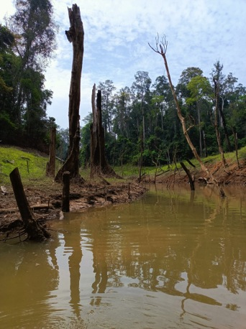
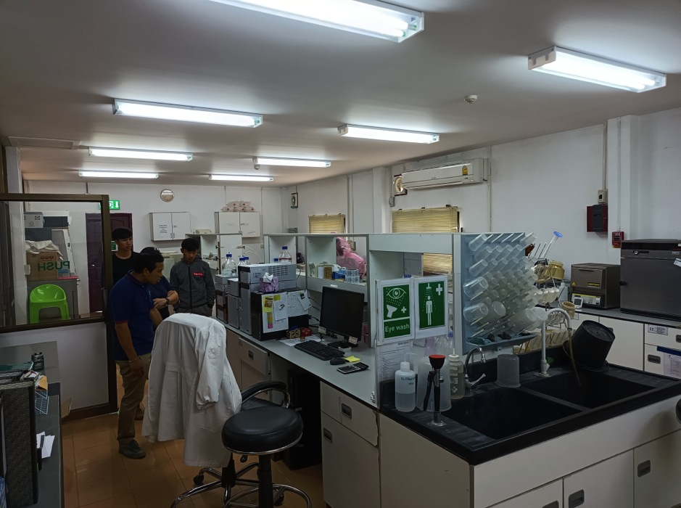
LAOS & THAILAND
Nakai International Environnemental Research
Centre- dedicated to One-Health Research
CIREN
PRotect
dEtect
DEHARO Eric
LOCATELLI Sabrina
PRAVONG Vatsana
A consortium of researchers and Institutions from Laos, Thailand and France

Slide 14
ONGOING PROJECTS- 1
LACOVISS- Epidemiological investigation of SARS-CoV-2 in Laos using a one-health approach
dEtect
DISCOVER- Natural history of SARS-CoV-2 : Emergence and Reservoir

Slide 15
ONGOING PROJECTS -2
VERDI
SARS-CoV-2 variants Evaluation in pRegnancy and paeDIatrics cohorts
Carlo Giaquinto and PENTA team, W Khamduang (CMU), N Ngo-Giang-Huong (MIVEGEC),
Marc Lallemant (DNDi)
COVID-19 Outreach Services
Outreach and contactless care services for COVID-19 testing
For asymptomatic individuals in Chiangmai and Lamphun, Thailand
For discharged COVID-19 patients in Chiangmai, Thailand
dEtect
STOp
Woottichai Khamduang (CMU), Nicole Ngo-Giang-Huong (MIVEGEC)
TB in Pets
Survey of tuberculosis in household pets living in pulmonary tuberculosis patient house
Anucha Sirimalaisuwan (CMU)
Viruses in Wildlife
Survey of zoonotic viruses in wildlife and high-risk human populations in Chiang Mai Province
Woottichai Khamduang (CMU), Premmarin Inmontian (CMU)
9
Notes:
TO BE UPDATED ?

